Slide 1
Cloud Security Challenges, Strategy, Control Mechanism and Privacy Issues
Ganga RavindRa
A20345490
ITM DEpartment

Slide 2
Objective
Cloud Delivery Models
Cloud Deployment models
Cloud Computing Obstacles
Common concern and Implications
Cloud Security Threat
Cloud Security Strategy

Slide 3
Cloud delivery models
Infrastructure as a Service (IaaS): are self-service models for accessing, monitoring, and managing remote datacenter infrastructures, storage, networking, and firewalls. Instead of having to purchase hardware outright, users can purchase IaaS based on consumption.
Platform as a Service (Paas): are used for applications, and other development, while providing cloud components to software. Developers gain with PaaS a framework they can build upon to develop or customize applications. PaaS makes the development, testing, and deployment of applications quick, simple, and cost-effective. With this technology, enterprise operations, or a third-party provider, can manage virtualization, servers, storage, networking, and the PaaS software itself.
Software as a Service or SaaS: SaaS uses the web to deliver applications that are managed by a third-party vendor and whose interface is accessed on the clients’ side. Most SaaS applications can be run directly from a web browser without any downloads or installations required. Popular SaaS offering types include email and collaboration, customer relationship management, and healthcare-related applications.

Slide 4
Deployment Models
The cloud infrastructure has been further sub-divided into;
Public cloud where the infrastructure resides totally outside of the tenant/enterprises/firewall.
Hybrid cloud where the infrastructure and business processes reside partly within the enterprise and partly consumed from third party.
Private cloud where IT services are mounted on top of large-scale infrastructure within enterprise firewall.

Slide 5
Cloud Computing Obstacles
Difficult to identify a particular physical resource that has a threat or has been compromised - This is because of dynamic scalability, service abstraction, and location transparency features of cloud computing models, the applications and data on the cloud platform have no fixed infrastructure and security boundaries.
Difficult to deploy a unified security measure - Since the cloud resources are owned by multiple providers, there is always a conflict of interest.
User data may be accessed by other unauthorized users - Due to the openness of cloud and it’s sharing of virtualized resources by multi-tenant, user data may be accessed by other unauthorized users.
Cloud security measures have to meet the need of fast data processing - As the cloud platform has to deal with massive data storage and to deliver increased access, cloud security measures have to meet the need of fast data processing.

Slide 6
COMMON CONCERN AND IMPLICATION
Cloud infrastructure, platform and hosted code -This category includes concerns that are related to possible virtualization, storage and networking vulnerabilities. The vulnerabilities that have an impact are the ones that originate in the cloud software platform stack and hosted code, which gets migrated to cloud. Data Center also imposes various security issues.
Data and information - This category comprises the concerns which involve data integrity, data confidentiality, data lock in, data reminisce, provenance, and user privacy related specific concerns.
Access control - This comprises the concern around cloud access (authentication, authorization and access control or AAA), encrypted data communication, and user identity management.
Compliance - Because of its bandwidth, wide fetched and disruptive influence, the cloud is constantly monitored and tracked by regulatory agencies, especially around security audit, data location; operation traceability and compliance concerns.

Slide 7
CLOUD SECURITY THREAT
Insider Threats
It is a well-known fact that most security threats arise from within an organization. This threat is common for consumers of cloud services since the cloud is based on a multi-tenant model, under a provider’s single management domain.
In addition to this, the organizations that subscribe to cloud services are usually unaware of the company’s hiring process of its employees. There is no visibility into the hiring standards and practices for cloud employees, by cloud provider to its consumers. This situation can make it a very easy and a tempting ground for casual hackers or malicious insiders.
Also, without any boundaries, the third party vendors for the particular providers can sneak into sensitive data and information of several users can be compromised.

Slide 8
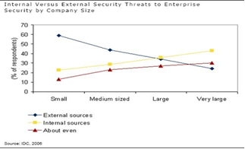
The following figure details the results of survey conducted by IDC to reflect the inside threat which is existent everywhere from small to very large size enterprises.
Example of insider vs. outsider threats

Slide 9
Outside Malicious Attacks
Outside threats are of concern since it directly connects to releasing any sensitive and confidential information out in the open if found in the wrong hands. It can be disastrous to the numerous users whose information was compromised. This is a long lasting and persistent issue faced by the cloud infrastructure.
Since the cloud architecture is more associable than private networks and have more interfaces that help its legitimate user’s access information, this provides leverage to hackers and attackers to their advantage by exploiting this weakness, connection tapping or breaking in and by social engineering.
Data Loss
There is considerable amount of difference in data integrity and safety when maintained on-premises and when migrated to cloud. This is because cloud systems are multi-tenant environment and do not provide the same level of access control. Care should be taken to prevent unauthorized parties from gaining access to sensitive data. Other factors responsible for data loss are inconsistent use of encryption and encryption keys, operational failures, political issues and data center reliability.

Slide 10
Service Disruption
Malicious attacks such as phishing, fraud, and exploitation of software vulnerabilities help hackers succeed in their mission. When an attacker gains access to an individual or organization’s login credentials, he can manipulate, retrieve or erase data. He can also redirect an organization’s client to illegitimate sites or launch a Denial of Service (DoS) attack. Such compromised user accounts can act as a launching base for the attacker from where, he can leverage a legit account to launch subsequent attacks which will go unnoticed and the attacker will be concealed. Service disruptions can cause a business to halt or even loose valuable customer base to competition.
Multitenancy issues
Multi-tenancy of cloud involves multiple users within the cloud, sharing the same applications and physical hardware to run their Virtual Machines. Though this concept has its benefits, this model also has some limitations in terms of security. The application and hardware sharing can enable information leakage and exploitation and it certainly helps increasing the attack. This model also enhances the risk of VM-to-VM attacks or compromised VM becoming a hub for future attacks.

Slide 11
Loss of Control
When organization’s move their services or information to cloud, they have no idea about the location of their data. This is because the provider can host their data anywhere in the cloud. From a user perspective, losing control over their data can be of huge concern. Also, since they are not aware of any security mechanisms put in place by the provider, it can be quite mysterious for the user and organizations.

Slide 12
CLOUD SECURITY STRATERGY
Ensure the applications have built in security mechanisms to avoid any buffer overflow, SQL injection etc. or any such attacks.
Implement a multi-layer security approach to contain or minimize the threats and ensure that even if an external/internal layer is breached, there are other layers to back it up.
For insider attacks, make sure that the employees are well trained, aware of legal terms, policies and have various technology tools to fight any threats originating on-premises (e.g. Antivirus, IPS, HIPS, internal firewalls, network segregation, monitoring)
In cases of service disrupting attacks, ensure security solutions like self-defending networks, Cloud aware security elements (NAC, dot1x etc.) are in place. Also, Data Center security techniques such as perimeter firewalls, IPS, ACLs can also be leveraged.
Ensure that multi-tenant systems are well isolated, even when on same hardware, there should be a context based firewall and rules supporting the individual domain holder’s security processes. This can be further strengthened by introduction of Single Sing On solution to validate sessions.
The organizations using cloud should have a sound understanding of security processes and of the SLAs with the cloud provider. This helps remove any discrepancies and creates a healthy working relationship between provider and customer.

Slide 13
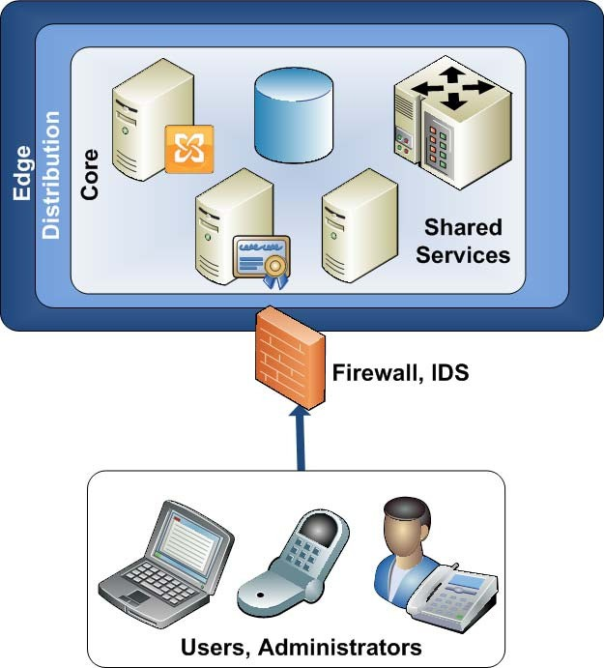
7. To counter external threats, ensure layered security in place, from perimeter to client machine, as shown in figure.
End to end protection by layered security approach
8. The organization and cloud customers should have a contingency plan in place to counter any outages or service disruptions, at least for the most critical applications or services. This can range from simple notification systems to backup repository of applications on-premises.

Slide 14
Conclusion
Cloud computing is related to many areas of information management and services. The data privacy issue are more prominent in cloud than in traditional network because the data in the cloud computing environment is greatly dependent on the network and server. Due to this some organizations are hesitant on moving their data over to cloud platform. These problems have hindered the development of cloud computing and the security issue is the core problem.
The cloud provider must take variety of measures to protect the security in order to effectively solve these problems.
There are well defined strategies that can be adopted to tighten cloud security and accelerate the growth of cloud computing.

Slide 15
Thank You

